Slide 1
CARDIAC POISONS
Dr. SANJU.S
Dept.of Forensic Medicine & Toxicology

Slide 2
CARDIAC POISONS
Nicotiana Tabacum
Nereium Odorum
Cerebera Thevetia
Cerebera Odallum
Aconite
Digitalis

Slide 3
NICOTIANA TABACUM
All parts of the plant-poisonous EXCEPT ripe seeds
Leaves contain Active Principle –TOXIC ALKALOIDS
*Nicotine
*Anabasine
*Nornicotine (Less Toxic)
Leaves are smoked,chewed or used as snuff (dried)
Contains nicotine 1%-8%

Slide 4
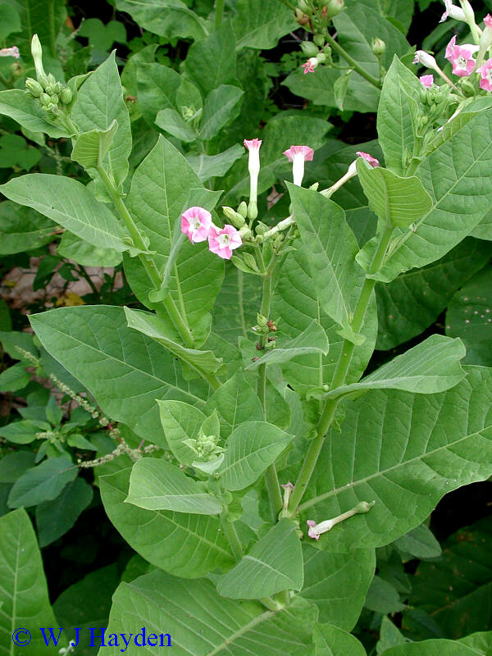
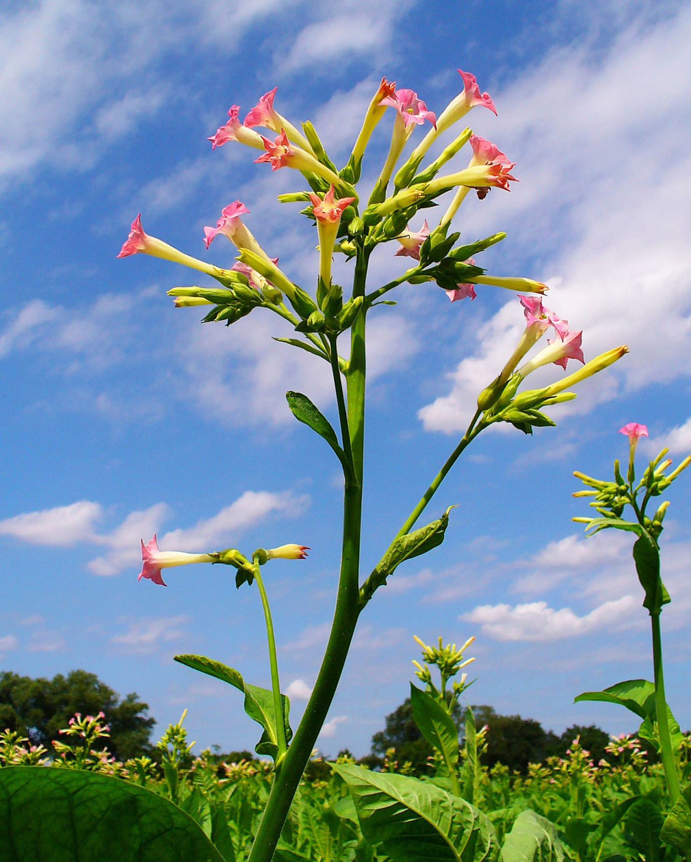
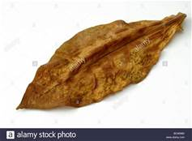
NICOTIANA TABACUM

Slide 5
NICOTINE
Colourless
Bitter
Hygroscopic
Volatile
Liquid alkaloid
Used in agricultural and holticultural work
For fumigating and Spraying
As worm powders and Insecticides

Slide 6
ACTION
On autonomic ganglia
Initial Stimulation
Depressed and blocked at later stage
Acts on Somatic neuromuscular junction
On afferent fibres from sensory receptors

Slide 7
ABSORPTION and EXCRETION
From all mucous membranes
Lungs
Skin
80%- 90% is metabolized in liver
some in Kidneys
lungs
Excreted by the kidneys

Slide 8
Cardiopulmonary
(EARLY)
Tachycardia
Hypertension
Tachypnoea
(LATE)
Bradycardia
Hypotension
Respiratory depression
Cardiac arrythymias

Slide 9
ACUTE POISONING
GIT –
Burning acid sensation
Nausea
Vomiting
Abdominal pain
Hypersalivation

Slide 10
CNS
(EARLY)
Miosis
Confusion
Sweating
Ataxia
Agitation
Restlessness
Hyperthermia
(LATE)
Mydriasis
Lethargy
Convulsions
Coma
(LATE)
DEATH MAY OCCUR FROM RESPIRATORY FAILURE

Slide 11
CHRONIC POISONING
Cough
Wheezing
Dyspnoea
Anorexia
Vomiting
Diarrhoea
Anaemia
Faintness
Tremors
Impaired Memory
Amblyopia
Blindness
Irregularity of heart with extra systoles
Attacks of pain suggesting angina pectoris

Slide 12
WITHDRAWAL SYMPTOMS
Intense urge to smoke
Anxiety
Impaired concentration and memory
Depression or hostility
Headache
Muscle cramps
Sleep disturbances
Increased appitite and weight gain
Diaphoresis
Rapid respirations

Slide 13
FATAL DOSE :-50-100mg of Nicotine 15 to 30gm of crude tobacco
FATAL PERIOD:- 5-15 minutes

Slide 14
TREATMENT
Stomach Wash:
Warm water containing charcoal ,tannin,or KMnO 4
Purge and colonic washout
Protect airway
Oxygen
Symptomatic

Slide 15
PM APPEARANCES
Those of asphyxia
Brownish froth at mouth and nostrils
Haemorrhagic congestion of GI tract
Pulmonary oedema
Stomach-fragments of seeds
Smell of tobacco

Slide 16
ML IMPORTANCE
Accidental-ingestion,excessive smoking,
Applicationof juice or leaves to wound or skin
Malingering-leaves are soaked in water for some hours
Placed in axilla at bedtime
Held in position by bandage
Poisonous symptoms next morning
Suicidal and homicidal RARE

Slide 17
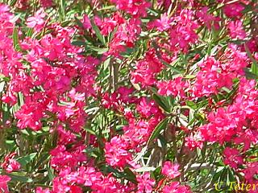
NERIUM ODORUM
Common oleander pink oleander ,rose laurel
Apocyanceae family
Grows wild in India
Flowers-fragrant, borne in terminal clusters ,white or pink
Leaves-long and pointed

Slide 18
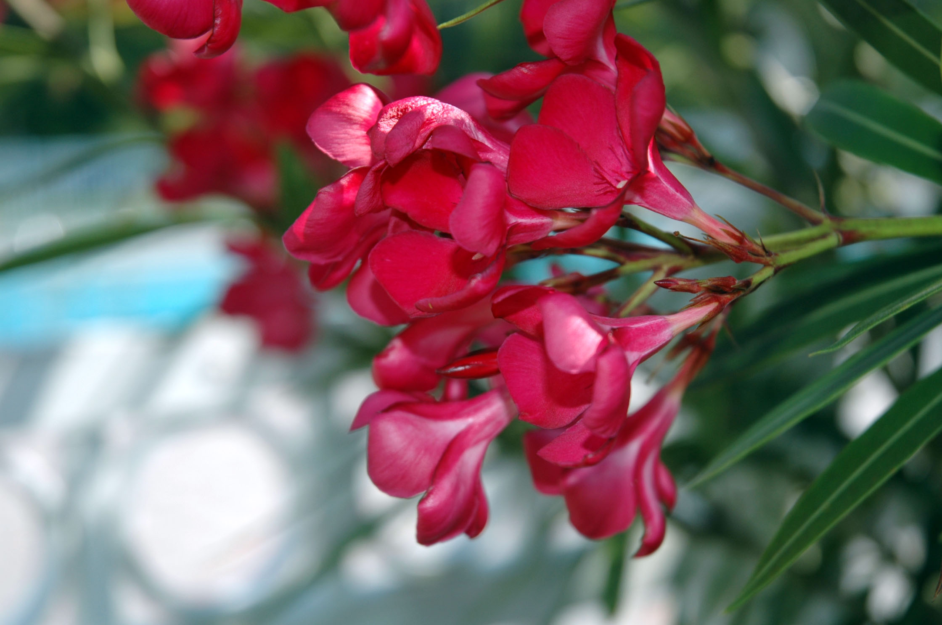

Slide 19
All parts of the plant are poisonous
Nectar yields poisonous honey
ACTIVE PRINCIPLES
Contains cardiac glycosides-
Oleandrin
Nerin
Rosagenin
Folinerin

Slide 20
Glycosides are compounds containing a carbohydrate and a noncarbohydrate residue in the same molecule.
The carbohydrate residue is attached to a noncarbohydrate residue or AGLYCONE.
The nonsugar component is known as the AGLYCONE. The sugar component is called the GLYCONE.
If the carbohydrate portion is glucose, the resulting compound is a GLUCOSIDE.

Slide 21
CLINICAL FEATURES
Dysphagia and dysarthria
Abdominal pain
Profuse frothy salivation
Nausea, vomiting
Pulse-first slow, later rapid and weak
Ventricular tachycardia, fibrillation, AV Block
BP falls
Muscular twitchings, tetanic spasms, lock jaw
Drowsiness, coma, respiratory paralysis
Death from CARDIAC FAILURE

Slide 22
FATAL DOSE :-15-20gm of the root;
5-15 leaves
FATAL PERIOD:-20-36 hrs
TREATMENT
Stomach Wash
ECG monitoring
Symptomatic

Slide 23
PM APPEARANCES
Not characteristic
Congestion of organs
CIRCUMSTANCES OF POISONING
Suicidal-decoction of root,leaves and seeds or paste
Homicide rare
Abortifacient- internally
Cattle poison-juice of the root is applied on a piece of cloth and
Inserted into the anus of the animal

Slide 24
CERBERA THEVATIA
Yellow oleander
Family-Apocyanaceae
All parts are poisonous
Flowers-tubular and Yellowish
Fruits-globular,greenish andfleshy-contains asingle nut
5 pale yellow seeds

Slide 25
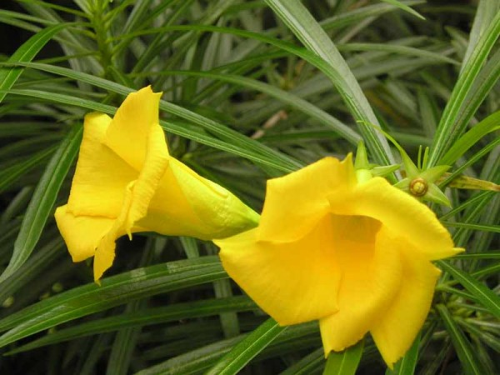

Slide 26
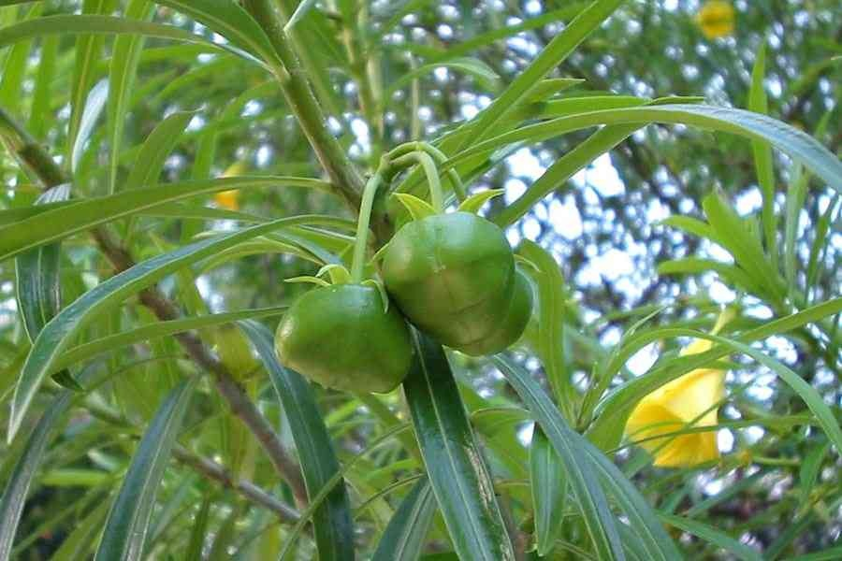

Slide 27
ACTIVE PRINCIPLES
Cardiac glycoside
Thevetin
Thevetoxin
Nerifolin
Peruvoside
Ruvoside

Slide 28
CLINICAL FEATURES
Sap can cause inflammation in sensitive individuals
Bark-when chewed-or seed kernel-numbing sensation,
Feeling of heat in mouth
Purging

Slide 29
INGESTION
Burning pain in mouth and throat
Dryness of throat
Tingling and numbness of tongue
Vomiting
Diarrhoea
Headache

Slide 30
Giddiness
Dialated pupils
Loss of muscular power
Fainting
Pulse-rapid ,weak and irregular
BP low
Heart Block ,collapse and death from peripheral circulatory failure

Slide 31
FATAL DOSE :-8-10 seeds;15-20gms of root; 5-10 leaves
FATAL PERIOD:-Uncertain
TREATMENT
Stomach Wash
Sodium molar lactate with glucose; atropine adrenaline and noradrenalin
Symptomatic

Slide 32
CEREBERA ODALLUM
Leaves are dark green fleshy and lanceolate
White flowers
Fruit resembles mango,globular and dark green thick fibrous mesocarp
Encloses a single seed
Milky acrid juice

Slide 33
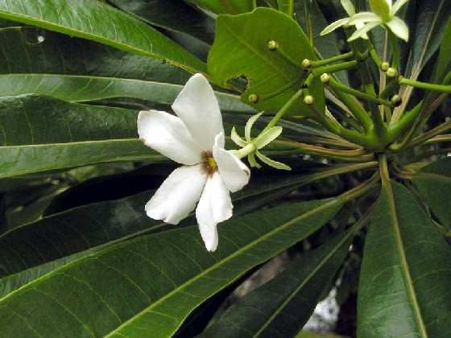
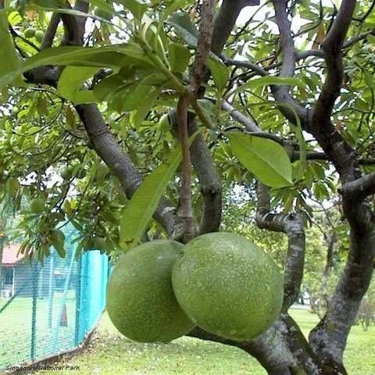
CEREBERA ODALLUM

Slide 34
ACTIVE PRINCIPLES
Cerebrin
Cerebroside
Odollin
Odolotoxin
Thevetin
Cerapain

Slide 35
CLINICAL FEATURES
Appear within 1 hour
Initial symptoms are gastrointestinal
Cardiac toxicity within 3 hrs
Bitter taste
Nausea
Severe Retching
Vomiting
Abdominal pain

Slide 36
In a few cases
Diarrhoea
General weakness
Blurring of vision
Sinus bradycardia
Irregular respiration
Collapse
Death from heart failure

Slide 37
FATAL DOSE :-Kernel of one fruit
FATAL PERIOD:-1-2 days or more
PM APPEARANCES
Those of asphyxia
Congestion of organs with petechial hges
TREATMENT
Stomach wash
Atropine
Correct hyperkalaemia

Slide 38
CIRCUMSTANCES OF POISONING
Suicide –mixed with jaggery or molasses
Homicide-powdered kernel added to alcohol
Bark leaves and milky juice as emetics and purgatives

Slide 39
ACONITE
Monk’s Hood,blue rocket
Common aconitum napellus, aconitum ferox
All parts of the plant are poisonous
Root is most potent

Slide 40
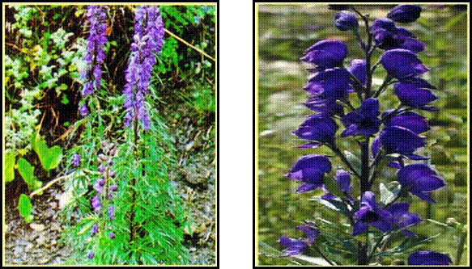
ACONITUM NAPELLUS

Slide 41
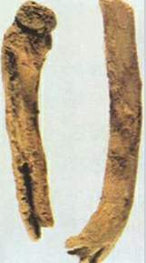
ACONITE
Dry root is conical and tapering
Arched or shriveled with longitudinal wrinkles
5-10cm long
11/2-2cm thick at the upper end
externally dark brown
when freshly cut-white
pink on exposure to air

Slide 42
Contains alkaloids
Aconitine
Pseudoaconitine
Mesoaconitine
Indaconitine
Bikhaconitine
Picraconitine
Aconine
Jesaconitine
Aconitine first stimulates then depresses the CNS

Slide 43
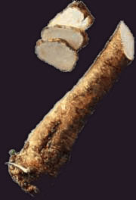
ACONITE
HORSERADISH

Slide 44
CLINICAL FEATURES
leaves on handling-tingling and numbness
odour has a narcotic effect
pollen –pain and swelling of eyes
s/s immediately or wihtin few minutes
Burning sensation from mouth to stomach
tingling and numbness in mouth,tongue,pharynx
then all over the body
pallor
Headache
Giddiness
Profuse sweating

Slide 45
Temp-subnormal
Limbs weak
Twitching of muscles
Darting pains
Cramps or convulsions
Pupils-hippos-constricted-later dialated
Hypotension
Cardiac arrythmias
AV Block
First tachy-later bradycardia
General muscular weakness
Oppression of chest
Death from paralysis of heart or resp:centres or both

Slide 46
FATAL DOSE -1-2gm root,4-5mg of aconitine
FATAL PERIOD-2-6 hrs
TREATMENT
Stomach wash with potassium iodide or tannic acid
Atropine
Symptomatic

Slide 47
PM APPEARANCES
Not characteristic
Those of asphyxia
Congestion of organs with petechial hges
CIRCUMSTANCES OF POISONING
Accidental –eating roots by mistake for horseradish
-use in quack remedies
-alcohol to increase intoxication
Suicide
With betel nut –to mask its taste-homicide
Abortifacient
Cattle poison
Arrow poison

Slide 48
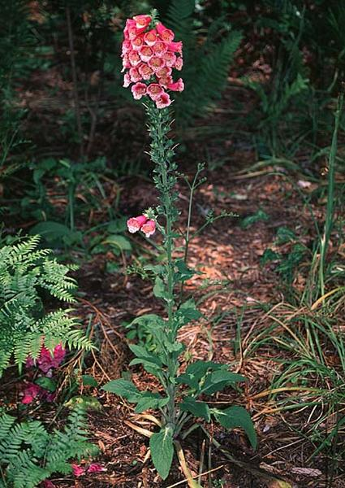
DIGITALIS

Slide 49
Common name: foxglove
A herb growing up to1 -1.5 meters
Leaves are hairy,ovate toothed, grey green in colour
Flowers :tubular, pink or white
Contains cardiac glycosides
- digitalin, digoxin , digitoxin
Digitalin is seen as fine white crystals
Odourless with a bitter taste
A cumulative poison

Slide 50
ACTION
Inhibit active transport of Na+ and K+ across cell membranes by binding onto a specific site of Na+/ K+ ATPase.
The force of contraction of the heart is increased.

Slide 51
Signs and Symptoms
Cardiac | Non-Cardiac
AV Block ( high degree) Ventricular ectopy, fibrillation Non paroxysmal arterial tachycardia Sinus bradycardia | Anorexia Nausea Vomiting Confusion Hyperkalaemia

Slide 52
Fatal dose and period
Digitalis leaf:2 gm
Digitalis:15 mg
Digoxin:10mg
FP: Few hours. (1-24)

Slide 53
Treatment
Decontamination
Antidote: Digoxin- specific antibody fragments
Hyperkalaemia:lV Insulin, Dextrose, Sodium bicarbonate

Slide 54
HYDROCYANIC ACID( Hydrogen cyanide, Prussic Acid)
By diluting potassium cyanide or ferrocyanide with prussic acid
Colourless, highly volatile liquid
Odour of bitter almonds
Powerful protoplasmic poison
Interferes with action of cytochrme oxidase
Prevents tissues from utilizing oxygen of blood
Produces cytotoxic hypoxia
Scheele’s acid-app:4%of pure acid

Slide 55
In nature-present in
Cherry laurel leaves
bitter almonds
cherry,plum kernels
apricot ,peach kernels etc

Slide 56
Symptoms
very rapidly acting poison
odour of HCN in breath
cofusion
anxiety
hyperapnoea
giddiness
Pt:staggers about
Eyes-wide open ,bright and shining
Pupil-dialated
Do not react to light

Slide 57
Consciousness lost
Resp;irregular,rapid,stertorous
Sudden short inspiration prolonged expiration
Convulsions may occur before death
Pulse-slow andfeeble later imperceptible
BP markedly low

Slide 58
Followed by cyanosis
Cold skin
Foam on the mouth
Relaxation of sphincters
Death from failure of respiration
Prevention of oxygen utilization by tissues

Slide 59
When small poisonous dose is taken
Bitter burning taste
Numbness or constriction of throat
Salivation
Giddiness
Nausea
Headache
confusion of ideas
oppression in chest

Slide 60
loss of muscular power
insensibility
Face-suffused or bloated
Mouth covered with froth
Eyes glassy and prominent
Dialated pupils
Cyanosis
Convulsions of tetanic character

Slide 61
Inhalation of vapours
Sense of constriction of throat and chest
Dizziness
Vertigo
Insensibility
Death from respiratory failure

Slide 62
KCN
Corrosive effect on mouth,throat,stomach
Epigastric pain and vomiting
Cyanosis of face,neck,hands
White froth on lips
Dialated pupils
Imperceptible pulse
Slow,shallow respiration
Incntinance of urine
Coma
Death

Slide 63
Chronic poisoning
People engaged in handlingHCN orKCN
Headache
Vertigo
Loss of appitite
Nausea
Constipation
Foetid dyspnoea
Anaemia

Slide 64
FATAL DOSE –
50mg pureHCN
2.5 ml dilute HCN
KCN -0.2-0.5 gm
Sodium cyanide-.15gm
FATAL PERIOD-2-10 minutes

Slide 65
TREATMENT
Should be immediate
Stabilization
Decontamination
Stomach wash with5%sodium thiosulphate solution

Slide 66
Antidotal treatment
Break 2cc ampule of amyl nitrate in a kerchief and hold over the patient’s nose
Sodium nitrate 3% soln-slow iv for5-10 minutes
Sodium thiosulphate-25%soln 3-5ml/min

Slide 67
Mechanism of action of nitrites
Induce methaemoglobinaemia
Causes detachment of cyanidesfrom cytochrome oxidase
Mechanism of action of sodium thiosulphate
Enables enzyme rhodanase to catabolise cyanide
Forms nontoxic thiocyanate
Excreted in urine

Slide 68
Other antidotes
4-DMAP
Cobalt EDTA
Hydroxocobalamin
Alpha ketoglutaric acid

Slide 69
PM APPEARANCES
odour of bitter almonds
brick red colour of skin and mucous membranes
cyanosis of extremities
froth at mouth and nostrils

Slide 70
Internal
Haemorrhagic gastritis
Pulmonary and cerebral oedema
Disseminated petechiae in brain meninges’pleura pericardium,lungs

Slide 71
CIRCUMSTANCES OF POISONING
Usually for suicide
Accidental inhalation of fumes
Rarely homicide and cattle poisoning

Slide 72
PM APPEARANCES
Nothing specific
ML importance: Occasionally homicidal
Accidental due to overdose

